Slide 1
CS 345 Lecture 1
Introduction
and Math Review

Slide 2
CS 345
Instructor
Qiyam Tung
TA
Sankar Veeramoni

Slide 3
Administrivia
Webpage
http://www.cs.arizona.edu/classes/cs345/summer14/
Syllabus
http://www.cs.arizona.edu/classes/cs345/summer14/syllabus.html

Slide 4
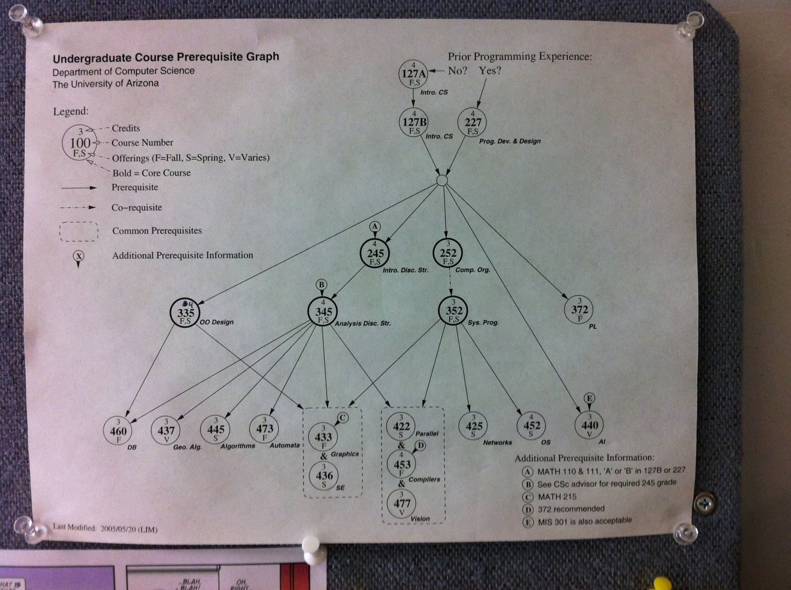

Slide 5
Sets
Union
Intersection

Slide 6
Sets (cont’d)
Membership
Defining sets
Even numbers
Odd numbers

Slide 7
Sets
Power set

Slide 8
Sequences
Summation
Products

Slide 9
Closed form equivalents
Triangular numbers
Sum of powers of 2

Slide 10
Logarithms
Product
Quotient

Slide 11
Logarithms (cont’d)
Power
Change of base

Slide 12
Logical Equivalences
De Morgan’s Law
Propositions
Sets

Slide 13
10 minute break

Slide 14
Proofs
Deductive
Contrapositive
Inductive

Slide 15
Proofs (cont’d)
Contradiction
p | q | ~p | p->q | ~p V q

Slide 16
Proofs (cont’d)

Slide 17
Deduction (example)
Conjecture: If x is even, then 5x is even

Slide 18
Deduction (cont’d)
Conjecture: If x is even, then 5x is even

Slide 19
Contrapositive (example)
Conjecture: If x^2 is odd, then x is odd

Slide 20
Contrapositive (cont’d)
Conjecture: If x^2 is odd, then x is odd

Slide 21
Inductive (example)
Conjecture:

Slide 22
Inductive (cont’d)

Slide 23
Inductive (cont’d)

Slide 24
Contradiction (example 1)
Conjecture: There are infinite prime numbers

Slide 25
Contradiction (example 1 cont’d)

Slide 26
Contradiction (example 1 cont’d)

Slide 27
Contradiction (example)
Conjecture: The square root of 2 is irrational

Slide 28
Contradiction (cont’d)

Slide 29
Contradiction (cont’d)

Slide 30
Extra 1

Slide 31
Extra 2

Slide 32
Extra 3

Slide 33
Extra 4

Slide 34
Extra 5

Slide 35
CS 345 Lecture 1
Introduction
and Math Review

Slide 36
CS 345
Instructor
Qiyam Tung
TA
Sankar Veeramoni

Slide 37
Administrivia
Webpage
http://www.cs.arizona.edu/classes/cs345/summer14/
Syllabus
http://www.cs.arizona.edu/classes/cs345/summer14/syllabus.html

Slide 39
Sets
Union
Intersection

Slide 40
Sets (cont’d)
Membership
Defining sets
Even numbers
Odd numbers

Slide 41
Sets
Power set

Slide 42
Sequences
Summation
Products

Slide 43
Closed form equivalents
Triangular numbers
Sum of powers of 2

Slide 44
Logarithms
Product
Quotient

Slide 45
Logarithms (cont’d)
Power
Change of base

Slide 46
Logical Equivalences
De Morgan’s Law
Propositions
Sets

Slide 47
10 minute break

Slide 48
Proofs
Deductive
Contrapositive
Inductive

Slide 49
Proofs (cont’d)
Contradiction
p | q | ~p | p->q | ~p V q

Slide 50
Proofs (cont’d)

Slide 51
Deduction (example)
Conjecture: If x is even, then 5x is even

Slide 52
Deduction (cont’d)
Conjecture: If x is even, then 5x is even

Slide 53
Contrapositive (example)
Conjecture: If x^2 is odd, then x is odd

Slide 54
Contrapositive (cont’d)
Conjecture: If x^2 is odd, then x is odd

Slide 55
Inductive (example)
Conjecture:

Slide 56
Inductive (cont’d)

Slide 57
Inductive (cont’d)

Slide 58
Contradiction (example 1)
Conjecture: There are infinite prime numbers

Slide 59
Contradiction (example 1 cont’d)

Slide 60
Contradiction (example 1 cont’d)

Slide 61
Contradiction (example)
Conjecture: The square root of 2 is irrational

Slide 62
Contradiction (cont’d)

Slide 63
Contradiction (cont’d)

Slide 64
Extra 1

Slide 65
Extra 2

Slide 66
Extra 3

Slide 67
Extra 4

Slide 68
Extra 5

