Slide 1
Lecture 2
Basic Data Structures
and Recursion Review

Slide 2
Online Students
Tell me what your plan is
in-class exam
proctoring

Slide 3
Participation 1
Blue Eyes Problem
Due Thursday

Slide 4
Abstract Data Type
Motivation
Grouping
Abstraction
Definition

Slide 5
List
Operations

Slide 6
List: array
Characteristics
Index calculation (constant)

Slide 7
List: array
1D array index calculation (constant)

Slide 8
List: array (cont’d)
2D array (RMO)

Slide 9
List: array (cont’d)
2D array (CMO)

Slide 10
List: array (cont’d)
3D array

Slide 11
List: array

Slide 12
List: array
Resizing: what’s the cost?
Increase capacity by 1
Increase capacity by 100%

Slide 13
List: linked list
Characteristics

Slide 15
List: doubly-linked list
Characteristics

Slide 16
List: doubly-linked list

Slide 17
List: Circular linked list
Characteristics

Slide 18
List: Circular linked list

Slide 19
List: Multi-List
Characteristics

Slide 20
List: Multi-List

Slide 21
Stacks
Operations

Slide 22
Stacks: arrays
Push()

Slide 23
Stacks: arrays
Pop()

Slide 24
Stacks: arrays

Slide 25
Stacks: linked lists
Push()

Slide 26
Stacks: linked lists
Pop()

Slide 27
Queues
Characteristics

Slide 28
Queues: linked list
enqueue

Slide 29
Queues: linked list
dequeue

Slide 30
Queues: array
enqueue

Slide 31
Queue: array
dequeue

Slide 32
Dictionary
Characteristics

Slide 33
Dictionary: implementations
Hash Table
B+ Trees

Slide 34
Other data structures
Trees
Graphs

Slide 35
Recursion Review
Definition

Slide 36
Recursion Review
Example: factorial

Slide 37
Recursion Review

Slide 38
Recursion Review
Any recursive function can be rewritten as a loop.

Slide 39
Recursion Review
Recursion vs loops

Slide 40
Recursion Review
Reverse Linked List (iterative)

Slide 41
Recursion Review
Reverse Linked List (recursive)

Slide 42
Recursion Review
Reverse Linked List (recursive)

Slide 43
Recursion Review

Slide 44
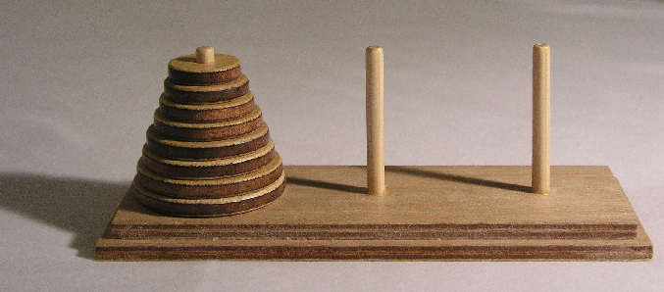
Recursion Review: Towers of Hanoi
image from wikipedia

Slide 45
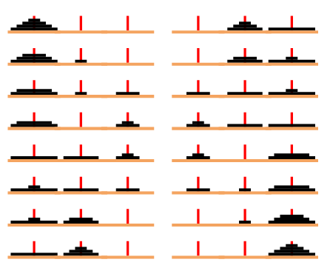
Recursion Review: Towers of Hanoi
image from mathworld.wolfram.com

Slide 46
Recursion Review
Solving Towers of Hanoi Recursively

Slide 47
Lecture 2
Basic Data Structures
and Recursion Review

Slide 48
Online Students
Tell me what your plan is
in-class exam
proctoring

Slide 49
Participation 1
Blue Eyes Problem
Due Thursday

Slide 50
Abstract Data Type
Motivation
Grouping
Abstraction
Definition

Slide 51
List
Operations

Slide 52
List: array
Characteristics
Index calculation (constant)

Slide 53
List: array
1D array index calculation (constant)

Slide 54
List: array (cont’d)
2D array (RMO)

Slide 55
List: array (cont’d)
2D array (CMO)

Slide 56
List: array (cont’d)
3D array

Slide 57
List: array

Slide 58
List: array
Resizing: what’s the cost?
Increase capacity by 1
Increase capacity by 100%

Slide 59
List: linked list
Characteristics

Slide 61
List: doubly-linked list
Characteristics

Slide 62
List: doubly-linked list

Slide 63
List: Circular linked list
Characteristics

Slide 64
List: Circular linked list

Slide 65
List: Multi-List
Characteristics

Slide 66
List: Multi-List

Slide 67
Stacks
Operations

Slide 68
Stacks: arrays
Push()

Slide 69
Stacks: arrays
Pop()

Slide 70
Stacks: arrays

Slide 71
Stacks: linked lists
Push()

Slide 72
Stacks: linked lists
Pop()

Slide 73
Queues
Characteristics

Slide 74
Queues: linked list
enqueue

Slide 75
Queues: linked list
dequeue

Slide 76
Queues: array
enqueue

Slide 77
Queue: array
dequeue

Slide 78
Dictionary
Characteristics

Slide 79
Dictionary: implementations
Hash Table
B+ Trees

Slide 80
Other data structures
Trees
Graphs

Slide 81
Recursion Review
Definition

Slide 82
Recursion Review
Example: factorial

Slide 83
Recursion Review

Slide 84
Recursion Review
Any recursive function can be rewritten as a loop.

Slide 85
Recursion Review
Recursion vs loops

Slide 86
Recursion Review
Reverse Linked List (iterative)

Slide 87
Recursion Review
Reverse Linked List (recursive)

Slide 88
Recursion Review
Reverse Linked List (recursive)

Slide 89
Recursion Review

Slide 90
Recursion Review: Towers of Hanoi
image from wikipedia

Slide 91
Recursion Review: Towers of Hanoi
image from mathworld.wolfram.com

Slide 92
Recursion Review
Solving Towers of Hanoi Recursively

