Slide 1
Lecture 3
Algorithm Analysis

Slide 2
Motivation
Which algorithm to use?

Slide 3
Step-Counting
Assumptions

Slide 4
Step-counting: equal work
Adding/Multiplication/Division
Trigonometric functions

Slide 5
Step-counting: no optimization
Unrolling Loops

Slide 6
Sample code (simple operations)

Slide 7
Sample code (while loop)

Slide 8
Sample code (for loop)

Slide 9
Sample code: conditionals

Slide 10
Sample code: conditionals

Slide 11
Which branch do we follow?
Best Case
Average Case
Worst Case

Slide 12
Code Sample
if (x < 0){
for (i = 0; i < n; i++){
print(n)
}
}
else
print false

Slide 13
Sample Code
for (i = 0; i < n; i++){
if (a[i] > x){
for (j = 0; j < n; j++){
b[j] = b[i]
}
}else{
b[j] = 0
}
}

Slide 14
Limitations of step-counting
Recursion
Do Constants Matter?

Slide 15
Asymptotic Analysis
Generalization/Categorization
Abstraction

Slide 16
Big-O
Definition

Slide 17
Graph

Slide 18
Using Big-O
Show 7n+8 = O(n)

Slide 19
Using Big-O

Slide 20
Using Big-O
Show 7n+8 = O(n^2)

Slide 21
Using Big-O

Slide 22
Upper Bounds

Slide 23
Common Labels
Function | Name | Example

Slide 24
Theorems

Slide 25
Theorems

Slide 26
Theorems

Slide 27
Function Properties

Slide 28
Useful Tool: limits

Slide 29
Properties of Big-O and friends
Symmetry
Transpose Symmetry

Slide 30
Properties of Big-O and friends
Reflexivity
Transitivity

Slide 31
Common Misunderstandings
Bounds vs. best/worst cases

Slide 32
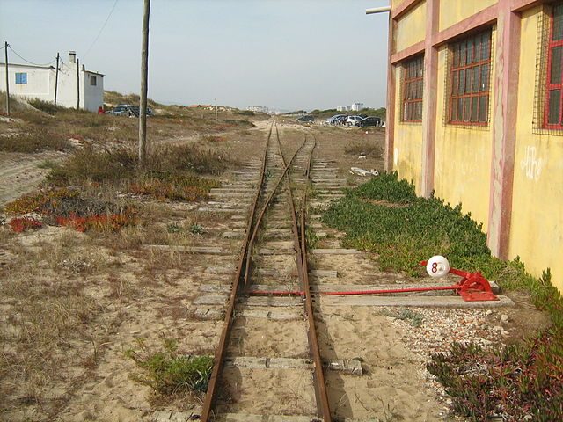
Asymptotic Analysis vs. Running time

Slide 33
Lecture 3
Algorithm Analysis

Slide 34
Motivation
Which algorithm to use?

Slide 35
Step-Counting
Assumptions

Slide 36
Step-counting: equal work
Adding/Multiplication/Division
Trigonometric functions

Slide 37
Step-counting: no optimization
Unrolling Loops

Slide 38
Sample code (simple operations)

Slide 39
Sample code (while loop)

Slide 40
Sample code (for loop)

Slide 41
Sample code: conditionals

Slide 42
Sample code: conditionals

Slide 43
Which branch do we follow?
Best Case
Average Case
Worst Case

Slide 44
Code Sample
if (x < 0){
for (i = 0; i < n; i++){
print(n)
}
}
else
print false

Slide 45
Sample Code
for (i = 0; i < n; i++){
if (a[i] > x){
for (j = 0; j < n; j++){
b[j] = b[i]
}
}else{
b[j] = 0
}
}

Slide 46
Limitations of step-counting
Recursion
Do Constants Matter?

Slide 47
Asymptotic Analysis
Generalization/Categorization
Abstraction

Slide 48
Big-O
Definition

Slide 49
Graph

Slide 50
Using Big-O
Show 7n+8 = O(n)

Slide 51
Using Big-O

Slide 52
Using Big-O
Show 7n+8 = O(n^2)

Slide 53
Using Big-O

Slide 54
Upper Bounds

Slide 55
Common Labels
Function | Name | Example

Slide 56
Theorems

Slide 57
Theorems

Slide 58
Theorems

Slide 59
Function Properties

Slide 60
Useful Tool: limits

Slide 61
Properties of Big-O and friends
Symmetry
Transpose Symmetry

Slide 62
Properties of Big-O and friends
Reflexivity
Transitivity

Slide 63
Common Misunderstandings
Bounds vs. best/worst cases

Slide 64
Asymptotic Analysis vs. Running time

