Slide 1
Lecture 3
Algorithm Analysis

Slide 2
Motivation
Which algorithm to use?

Slide 3
Step-Counting
Assumptions

Slide 4
Step-counting: equal work
Adding/Multiplication/Division
Trigonometric functions

Slide 5
Step-counting: no optimization
Unrolling Loops

Slide 6
Sample code (simple operations)

Slide 7
Announcements
Test dates will not be changed
Participation 1 is due

Slide 8
Blue Eyes
Solution?
What is the proof?

Slide 9
Blue Eyes

Slide 10
Blue Eyes

Slide 11
The actual hardest (?) logic puzzle ever
Three gods A, B, and C are called, in no particular order, True, False, and Random. True always speaks truly, False always speaks falsely, but whether Random speaks truly or falsely is a completely random matter. Your task is to determine the identities of A, B, and C by asking three yes-no questions; each question must be put to exactly one god. The gods understand English, but will answer all questions in their own language, in which the words for yes and no are da and ja, in some order. You do not know which word means which

Slide 12
Sample code (while loop)

Slide 13
Sample code (for loop)

Slide 14
Sample code: conditionals

Slide 15
Sample code: conditionals

Slide 16
Which branch do we follow?
Best Case
Average Case
Worst Case

Slide 17
Code Sample
if (x < 0){
for (i = 0; i < n; i++){
print(n)
}
}
else
print false

Slide 18
Sample Code
for (i = 0; i < n; i++){
if (a[i] > x){
for (j = 0; j < n; j++){
b[j] = b[i]
}
}else{
b[j] = 0
}
}

Slide 19
Limitations of step-counting
Recursion
Do Constants Matter?

Slide 20
Asymptotic Analysis
Generalization/Categorization
Abstraction

Slide 21
Big-O
Definition

Slide 22
Graph

Slide 23
Using Big-O
Show 7n+8 = O(n)

Slide 24
Using Big-O

Slide 25
Using Big-O
Show 7n+8 = O(n^2)

Slide 26
Using Big-O

Slide 27
Upper Bounds

Slide 28
Common Labels
Function | Name | Example

Slide 29
Theorems
“Polynomial Theorem”

Slide 30
Theorems

Slide 31
Theorems

Slide 32
Theorems

Slide 33
Function Properties

Slide 34
Useful Tool: limits

Slide 35
Properties of Big-O and friends
Symmetry
Transpose Symmetry

Slide 36
Properties of Big-O and friends
Reflexivity
Transitivity

Slide 37
Common Misunderstandings
Bounds vs. best/worst cases

Slide 38
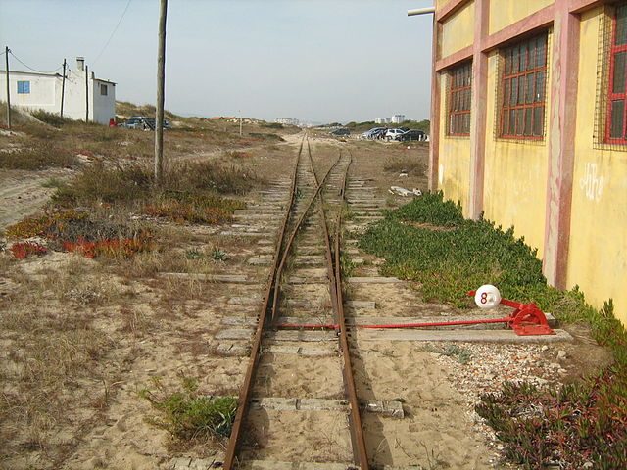
Asymptotic Analysis vs. Running time

Slide 39
Lecture 3
Algorithm Analysis

Slide 40
Motivation
Which algorithm to use?

Slide 41
Step-Counting
Assumptions

Slide 42
Step-counting: equal work
Adding/Multiplication/Division
Trigonometric functions

Slide 43
Step-counting: no optimization
Unrolling Loops

Slide 44
Sample code (simple operations)

Slide 45
Announcements
Test dates will not be changed
Participation 1 is due

Slide 46
Blue Eyes
Solution?
What is the proof?
What are the sources of information?

Slide 47
The real(?) hardest logic puzzle ever
Three gods A, B, and C are called, in no particular order, True, False, and Random. True always speaks truly, False always speaks falsely, but whether Random speaks truly or falsely is a completely random matter. Your task is to determine the identities of A, B, and C by asking three yes-no questions; each question must be put to exactly one god. The gods understand English, but will answer all questions in their own language, in which the words for yes and no are da and ja, in some order. You do not know which word means which

Slide 48
Sample code (while loop)

Slide 49
Sample code (for loop)

Slide 50
Sample code: conditionals

Slide 51
Sample code: conditionals

Slide 52
Which branch do we follow?
Best Case
Average Case
Worst Case

Slide 53
Code Sample
if (x < 0){
for (i = 0; i < n; i++){
print(n)
}
}
else
print false

Slide 54
Sample Code
for (i = 0; i < n; i++){
if (a[i] > x){
for (j = 0; j < n; j++){
b[j] = b[i]
}
}else{
b[j] = 0
}
}

Slide 55
Limitations of step-counting
Recursion
Do Constants Matter?

Slide 56
Asymptotic Analysis
Generalization/Categorization
Abstraction

Slide 57
Big-O
Definition

Slide 58
Graph

Slide 59
Using Big-O
Show 7n+8 = O(n)

Slide 60
Using Big-O

Slide 61
Using Big-O
Show 7n+8 = O(n^2)

Slide 62
Using Big-O

Slide 63
Upper Bounds

Slide 64
Common Labels
Function | Name | Example

Slide 65
Theorems

Slide 66
Theorems

Slide 67
Theorems

Slide 68
Function Properties

Slide 69
Useful Tool: limits

Slide 70
Properties of Big-O and friends
Symmetry
Transpose Symmetry

Slide 71
Properties of Big-O and friends
Reflexivity
Transitivity

Slide 72
Common Misunderstandings
Bounds vs. best/worst cases

Slide 73
Asymptotic Analysis vs. Running time

