Slide 1
Lecture 3
Algorithm Analysis

Slide 2
Motivation
Which algorithm to use?

Slide 3
Step-Counting
Assumptions

Slide 4
Step-counting: equal work
Adding/Multiplication/Division
Trigonometric functions

Slide 5
Step-counting: no optimization
Unrolling Loops

Slide 6
Sample code (simple operations)

Slide 7
Announcements
Test dates will not be changed
Participation 1 is due

Slide 8
Blue Eyes
Solution?
What is the proof?

Slide 9
Blue Eyes

Slide 10
Blue Eyes

Slide 11
The actual hardest (?) logic puzzle ever
Three gods A, B, and C are called, in no particular order, True, False, and Random. True always speaks truly, False always speaks falsely, but whether Random speaks truly or falsely is a completely random matter. Your task is to determine the identities of A, B, and C by asking three yes-no questions; each question must be put to exactly one god. The gods understand English, but will answer all questions in their own language, in which the words for yes and no are da and ja, in some order. You do not know which word means which

Slide 12
Sample code (while loop)

Slide 13
Sample code (for loop)

Slide 14
Sample code: conditionals

Slide 15
Sample code: conditionals

Slide 16
Which branch do we follow?
Best Case
Average Case
Worst Case

Slide 17
Code Sample
if (x < 0){
for (i = 0; i < n; i++){
print(n)
}
}
else
print false

Slide 18
Sample Code
for (i = 0; i < n; i++){
if (a[i] > x){
for (j = 0; j < n; j++){
b[j] = b[i]
}
}else{
b[j] = 0
}
}

Slide 19
Limitations of step-counting
Recursion
Do Constants Matter?

Slide 20
Asymptotic Analysis
Generalization/Categorization
Abstraction

Slide 21
Big-O
Definition

Slide 22
Graph

Slide 23
Using Big-O
Show 7n+8 = O(n)

Slide 24
Using Big-O

Slide 25
Using Big-O
Show 7n+8 = O(n^2)

Slide 26
Using Big-O

Slide 27
Announcements
Homework 1 due
Homework 2 is up
Participation one to be graded

Slide 28
Upper Bounds

Slide 29
Common Labels
Function | Name | Example

Slide 30
Theorems
“Polynomial Theorem”

Slide 31
Theorems

Slide 32
Theorems

Slide 33
Theorems

Slide 34
Function Properties

Slide 35
Useful Tool: limits

Slide 36
Example: little-omega
n = ω(n) ?

Slide 37
Example: little-omega
n^2 = ω(n)

Slide 38
Example: little-omega
e^n = ω(logn)

Slide 39
Properties of Big-O and friends
Symmetry
Transpose Symmetry

Slide 40
Properties of Big-O and friends
Reflexivity
Transitivity

Slide 41
Properties of Big-O and friends
for (i = 0; i < n; i++)
{
for (j=0; j < n; j++)
{
a[i][j] = 0;
}
}
for (i = 0, j = 0; i < n && j < n; i++, j++)
{
print(a[i][j]);
}

Slide 42
Common Misunderstandings
Size vs. best/worst case

Slide 43
Common Misunderstandings
Bounds vs. best/worst cases

Slide 44
Clarifications: limits for little-o and little-omega

Slide 45
Instance Characteristic
Two for loops
Iterating through an nxm matrix

Slide 46
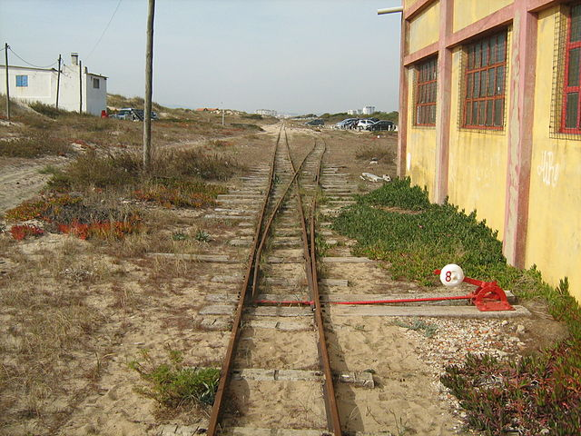
Asymptotic Analysis vs. Running time

Slide 47
Lecture 3
Algorithm Analysis

Slide 48
Motivation
Which algorithm to use?

Slide 49
Step-Counting
Assumptions

Slide 50
Step-counting: equal work
Adding/Multiplication/Division
Trigonometric functions

Slide 51
Step-counting: no optimization
Unrolling Loops

Slide 52
Sample code (simple operations)

Slide 53
Announcements
Test dates will not be changed
Participation 1 is due

Slide 54
Blue Eyes
Solution?
What is the proof?
What are the sources of information?

Slide 55
The real(?) hardest logic puzzle ever
Three gods A, B, and C are called, in no particular order, True, False, and Random. True always speaks truly, False always speaks falsely, but whether Random speaks truly or falsely is a completely random matter. Your task is to determine the identities of A, B, and C by asking three yes-no questions; each question must be put to exactly one god. The gods understand English, but will answer all questions in their own language, in which the words for yes and no are da and ja, in some order. You do not know which word means which

Slide 56
Sample code (while loop)

Slide 57
Sample code (for loop)

Slide 58
Sample code: conditionals

Slide 59
Sample code: conditionals

Slide 60
Which branch do we follow?
Best Case
Average Case
Worst Case

Slide 61
Code Sample
if (x < 0){
for (i = 0; i < n; i++){
print(n)
}
}
else
print false

Slide 62
Sample Code
for (i = 0; i < n; i++){
if (a[i] > x){
for (j = 0; j < n; j++){
b[j] = b[i]
}
}else{
b[j] = 0
}
}

Slide 63
Limitations of step-counting
Recursion
Do Constants Matter?

Slide 64
Asymptotic Analysis
Generalization/Categorization
Abstraction

Slide 65
Big-O
Definition

Slide 66
Graph

Slide 67
Using Big-O
Show 7n+8 = O(n)

Slide 68
Using Big-O

Slide 69
Using Big-O
Show 7n+8 = O(n^2)

Slide 70
Using Big-O

Slide 71
Upper Bounds

Slide 72
Common Labels
Function | Name | Example

Slide 73
Theorems

Slide 74
Theorems

Slide 75
Theorems

Slide 76
Function Properties

Slide 77
Useful Tool: limits

Slide 78
Example: little-omega
n = ω(n) ?

Slide 79
Example: little-omega
N^2 = ω(n)

Slide 80
Example: little-omega
e^n = ω(logn)

Slide 81
Properties of Big-O and friends
Symmetry
Transpose Symmetry

Slide 82
Properties of Big-O and friends
Reflexivity
Transitivity

Slide 83
Properties of Big-O and friends
for (i = 0; i < n; i++)
{
for (j=0; j < n; j++)
{
a[i][j] = 0;
}
}
for (i = 0, j = 0; i < n && j < n; i++, j++)
{
print(a[i][j]);
}

Slide 84
Common Misunderstandings
Bounds vs. best/worst cases

Slide 85
Common Misunderstandings
Bounds vs. best/worst cases

Slide 86
Clarifications: limits for little-o and little-omega

Slide 87
Instance Characteristic
Two for loops
Iterating through an nxm matrix

Slide 88
Asymptotic Analysis vs. Running time

