Slide 1
Topic 10
Trees

Slide 2
Tree Definitions

Slide 3
Tree Definitions

Slide 4
Tree Definitions

Slide 5
Binary Search Tree

Slide 6
Traversal
Operations tree

Slide 7
Announcements
Participation 4 is up
Homework 3 grading
Homework 4 grading

Slide 9
Search

Slide 11
Insertion

Slide 13
Deletion
Need
Min/max
Successor/predecessor

Slide 16
Pseudocode

Slide 17
Pseudocode

Slide 18
AVL

Slide 19
Height of AVL Tree

Slide 20
Proof

Slide 22
Insertion

Slide 23
Example

Slide 24
Single Right

Slide 25
Left-Right

Slide 26
Four cases

Slide 27
Deletions

Slide 28
Example

Slide 30
Announcements
Test in 2 weeks
Participation due tomorrow
Clarification

Slide 31
Splay Trees

Slide 32
Amortized Running Time
Runtime:

Slide 33
Basic Operations

Slide 34
When to Splay

Slide 35
Zig

Slide 36
Zig-Zag

Slide 37
Zig-zig

Slide 38
Example

Slide 43
Deletion

Slide 46
Optimal BST

Slide 47
Notation

Slide 48
Example

Slide 49
Example

Slide 50
More Notation
(i,j)
(j+1, j)

Slide 51
Observations

Slide 52
Observations

Slide 53
Announcements
Participation due
Clarifications on previous topics today
Splay tree deletion
Universal Hashing

Slide 54
Guaranteeing O(n) time

Slide 55
Birthday Paradox

Slide 56
Universal Hashing (clarification)

Slide 59
Computing the Optimal BST
How to compute cost?
Subtree at different depths

Slide 60
w(i,j)

Slide 61
AST

Slide 62
AST

Slide 63
Example
Sequences/Probabilities

Slide 64
Leaves

Slide 65
The Big Idea

Slide 67
Subtrees with one key

Slide 68
Subtrees with 2 keys

Slide 69
Solution

Slide 70
Announcements
Homework 5 due
Solutions will be up later today
Homework 6 up

Slide 73
2-3 Trees
A search tree
Properties

Slide 75
Insertion

Slide 77
Deletion
Remove
Borrow
Coalesce
Apply recursively

Slide 78
Remove

Slide 79
Borrow

Slide 80
Coalesce

Slide 81
Generalizing/Example

Slide 90
2-3-4 trees, B-trees
Why use 2-3 trees?

Slide 91
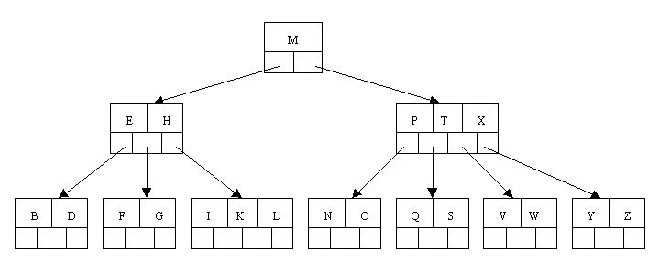

Slide 92
