Slide 1
Topic 12
Graphs 1

Slide 2
Graphs
Definition:
Two types:

Slide 3
Undirected

Slide 4
Directed

Slide 5
Examples/Applications

Slide 6
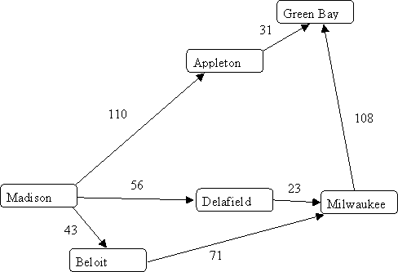
Transportation Networks
Shortest path?
Source: pages.cs.wisc.edu

Slide 7
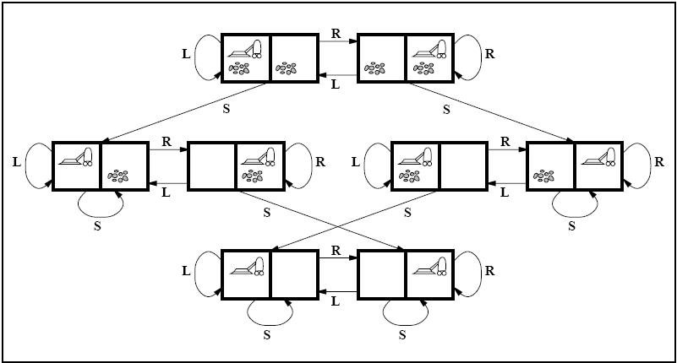
Vacuum World (from AI)
What belief states could we be in if we do a certain sequence of actions?
Source: centurion2.com

Slide 8
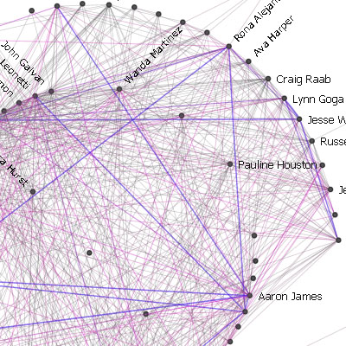
Social Network
Are you an introvert?
Who are you most friendly with?
Source: infosthetics.com

Slide 9
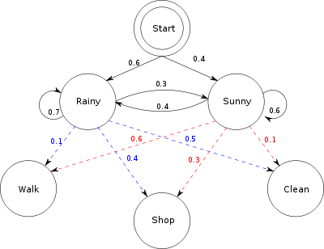
Graphical Models (from machine learning)
What was the most likely sequence of weather given the actions (walking, shopping, cleaning) on those days?
Source: wikipedia.org

Slide 10
Graphical Models
What is the most probable configuration that created this image?
Source: PRML by Christopher Bishop

Slide 11
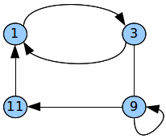
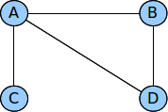
More Definitions
Path:
Length:

Slide 12
Cycle:
Self-loop:

Slide 13
Incident edges

Slide 14
Simple graph:
Acyclic graph:

Slide 15
Subgraph:
Forest:
Tree

Slide 16
Connected:
Complete graph:

Slide 17
Weighted graph:

Slide 18
Announcements
Homework 6 due
Test on Thursday (material up to Tuesday)
Reminder: survey
Review on Wednesday

Slide 32
Announcements
Survey
Quizzes/Graph sample problems online
Participation

Slide 33
Graph Representations

Slide 34
Adjacency Matrix (undirected)

Slide 35
Storing for Undirected

Slide 36
Adjacency Matrix (directed)
Pros:
Cons:

Slide 37
Adjacency Matrix Costs
Space:
Adjacency check:
Listing edges of node:

Slide 38
Adjacency list (undirected)

Slide 39
Adjacency list (directed)

Slide 40
Adjacency List Costs
Space:
Adjacency check:
Listing edges of node:

Slide 41
Graph Search/Traversals
How do get from one node to another?
Why?

Slide 42
Idea
Layers:

Slide 43
Breadth First Search: Algorithm

Slide 44
Example

Slide 46
BFS Tree

Slide 49
Depth-First Search
Applications:
Running time:

Slide 50
Recursive Algorithm

Slide 51
Iterative Algorithm

Slide 52
Example

