Slide 1
Topic 13
Graphs 2

Slide 2
Minimum Spanning Tree (MST)

Slide 3
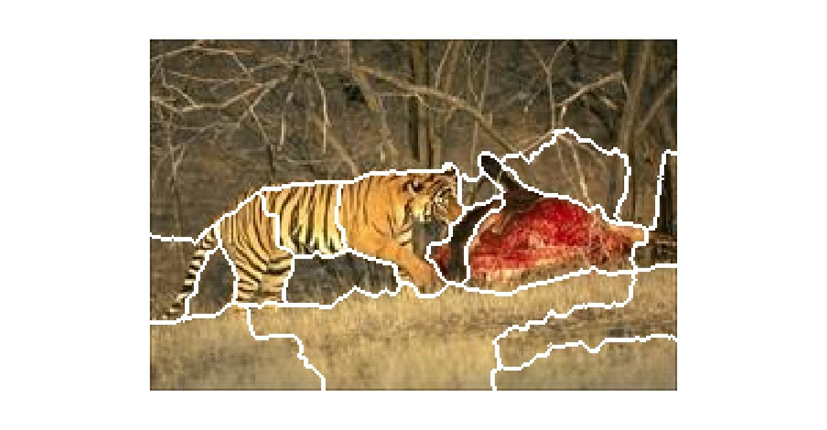
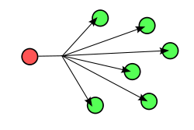
Applications
mathworks.com
Wikipedia.com

Slide 4
Prim’s MST Algorithm

Slide 5
Pseudocode

Slide 6
Proof

Slide 9
Kruskal’s MST Algorithm

Slide 12
Single Source Shortest Path Algorithms (SSSP)
Definition:

Slide 13
Example of paths

Slide 14
Dijkstra’s Algorithm
S | Q

Slide 16
Pseudocode

Slide 17
Bellman-Ford
 | d(source, *) | Parent
Edge (u->v) | Pass 1 | Pass 2 | Pass 3 | N.W.C. Test

Slide 18
Pseudocode

