Slide 1
Topic 13
Graphs 2

Slide 2
Minimum Spanning Tree (MST)

Slide 3
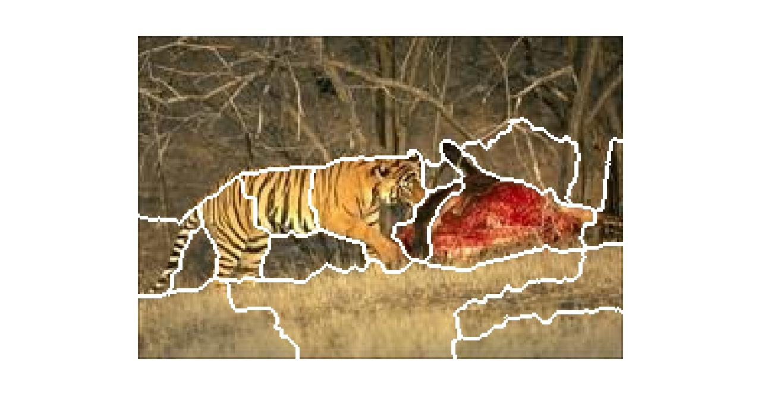
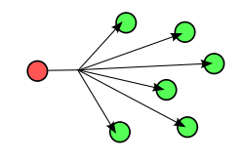
Applications
mathworks.com
Wikipedia.com

Slide 4
Prim’s MST Algorithm

Slide 5
Pseudocode

Slide 6
Proof

Slide 9
Kruskal’s MST Algorithm

Slide 12
Announcements
Homework 7 is up
Participation 6 is up
Final in 2 weeks
No office hours next Thursday

Slide 13
Single Source Shortest Path Algorithms (SSSP)
Definition:

Slide 14
Dijkstra’s Algorithm

Slide 15
Dijkstra’s Algorithm
Known | Fringe

Slide 16
Pseudocode

Slide 17
Analysis

Slide 18
Using Heaps

Slide 19
Observation (before proof)

Slide 20
Proof

Slide 21
SSSP using BFS

Slide 24
Bellman-Ford
 | d(source, *) | Parent
Edge (u->v) | Pass 1 | Pass 2 | Pass 3

Slide 25
Pseudocode

Slide 26
Analysis

Slide 27
Topological Sort
Def:

Slide 28
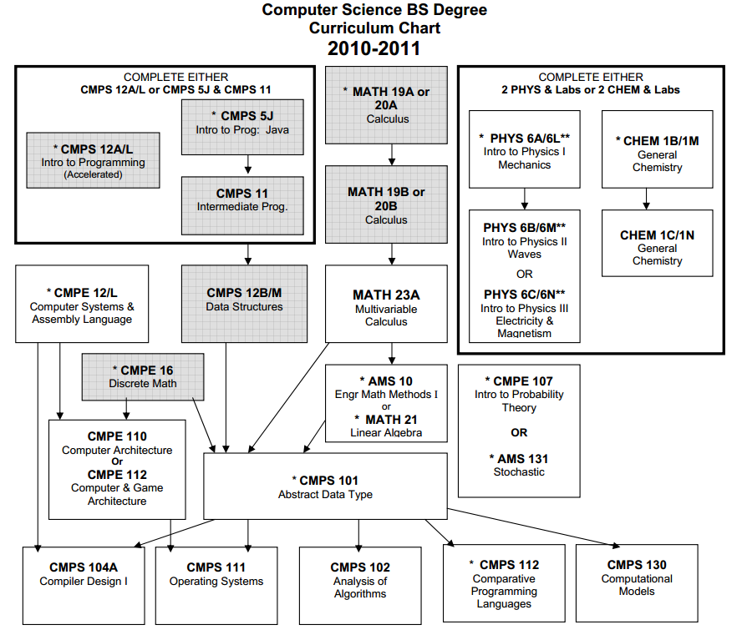
UC Santa Cruz Curriculum

Slide 29
SLIC
System has a lot of dependences → use Makefiles

Slide 30
Example

Slide 31
Pseudocode

Slide 32
Analysis

