Slide 1
Topic 13
Graphs 2

Slide 2
Minimum Spanning Tree (MST)

Slide 3
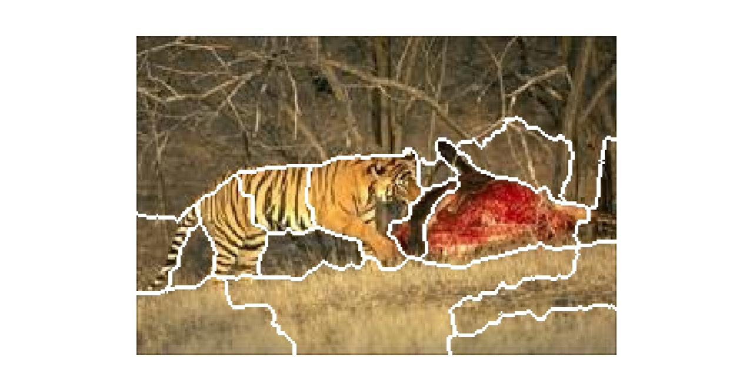
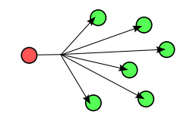
Applications
mathworks.com
Wikipedia.com

Slide 4
Prim’s MST Algorithm

Slide 5
Pseudocode

Slide 6
Proof

Slide 9
Kruskal’s MST Algorithm

Slide 12
Announcements
Homework 7 is up
Participation 6 is up
Final in 2 weeks
No office hours next Thursday

Slide 13
Single Source Shortest Path Algorithms (SSSP)
Definition:

Slide 14
Dijkstra’s Algorithm

Slide 15
Dijkstra’s Algorithm
Known | Fringe

Slide 16
Pseudocode

Slide 17
Analysis

Slide 18
Using Heaps

Slide 19
Observation (before proof)

Slide 20
Proof

Slide 21
SSSP using BFS

Slide 22
Announcements
Exams for online/proctored students to be finished (Thursday/Friday).
Final is 2 hours (9 to 11) on Wednesday
Incoming topics
Algorithm Families
Greedy
Dynamic Programming
Genetic Algorithms
Theory of Computation (grammars, finite state machines, P = NP, Halting Problem)
There will be many non-essential asides. Non-essential for the final, but helpful for CS education (I hope!)

Slide 25
Bellman-Ford
 | d(source, *) | Parent
Edge (u->v) | Pass 1 | Pass 2 | Pass 3

Slide 26
Pseudocode

Slide 27
Analysis

Slide 28
Topological Sort
Def:

Slide 29
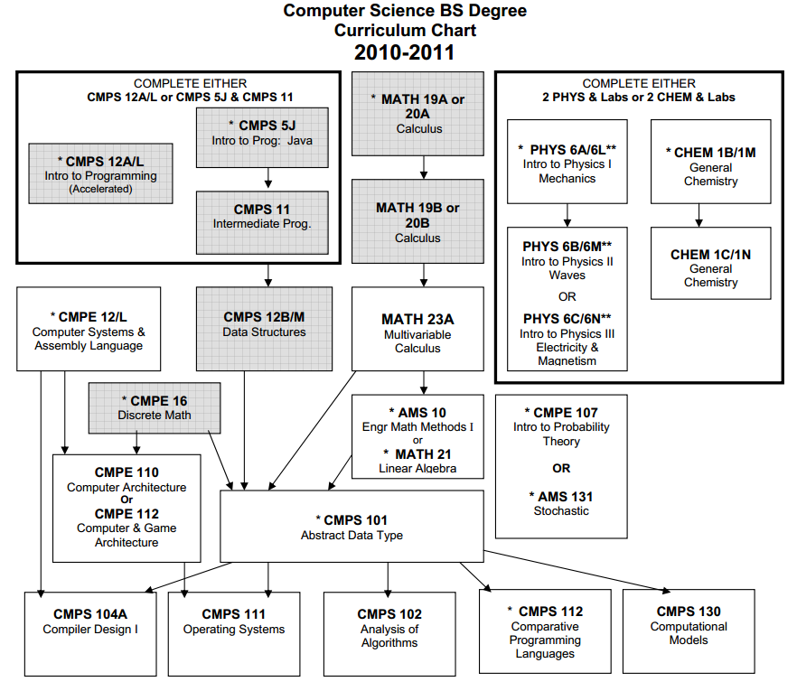
UC Santa Cruz Curriculum

Slide 30
SLIC
System has a lot of dependences → use Makefiles

Slide 31
Example

Slide 32
Pseudocode

Slide 33
Analysis

