Slide 1
Topic 14
Algorithm Families

Slide 2
A Partial List
Greedy Algorithms
Backtracking
Approximation Algorithms
Divide and Conquer
Families in Optimization Problems
Dynamic programming
Linear programming
Genetic Algorithms
Simulated annealing

Slide 3
Backtracking

Slide 4
N-Queens

Slide 5
Hamiltonian Cycle

Slide 6
Announcements
Participation is due

Slide 7
Maze Generation

Slide 9
+ | + | + | + | + | + | +
+ | + | + | + | + | + | +
+ | + | + | + | + | + | +
+ | + | + | + | + | + | +
+ | + | + | + | + | + | +
+ | + | + | + | + | + | +
+ | + | + | + | + | + | +

Slide 10
Approximation Algorithms

Slide 15
Divide and Conquer

Slide 16
Randomized Algorithms

Slide 17
Greedy Algorithms
Characteristics
Sets
Functions

Slide 18
Examples

Slide 19
Making Change

Slide 23
Announcements
Homework 7 due
Will go over tomorrow
Homework 8 will be out soon
Reminder: Final is on Wednesday from 9-11

Slide 24
Optimization problems
Dynamic programming
Linear programming
Genetic algorithms
Simulated annealing

Slide 25
Dynamic Programming

Slide 27
Total number of paths

Slide 28
Paths in 2x2

Slide 29
Paths in 4x4?

Slide 30
Base Cases

Slide 31
Recursive

Slide 32
Computing 4x4
0 | 1 | 2 | 3 | 4
1
2
3
4

Slide 33
Floyd’s Shortest Path Algorithm

Slide 36
A0
 | A | B | C | D | E | F
A
B
C
D
E
F

Slide 37
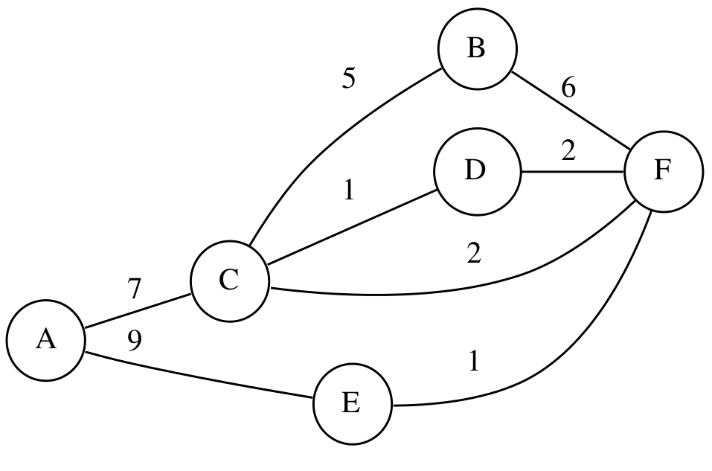
A1
 | A | B | C | D | E | F
A | 0
B |  | 0
C |  |  | 0
D |  |  |  | 0
E |  |  |  |  | 0
F |  |  |  |  |  | 0

Slide 38
A2
 | A | B | C | D | E | F
A | 0
B |  | 0
C |  |  | 0
D |  |  |  | 0
E |  |  |  |  | 0
F |  |  |  |  |  | 0

Slide 39
A3
 | A | B | C | D | E | F
A | 0
B |  | 0
C |  |  | 0
D |  |  |  | 0
E |  |  |  |  | 0
F |  |  |  |  |  | 0

Slide 40
A4
 | A | B | C | D | E | F
A | 0
B |  | 0
C |  |  | 0
D |  |  |  | 0
E |  |  |  |  | 0
F |  |  |  |  |  | 0

Slide 41
A5
 | A | B | C | D | E | F
A | 0
B |  | 0
C |  |  | 0
D |  |  |  | 0
E |  |  |  |  | 0
F |  |  |  |  |  | 0

Slide 42
A6
 | A | B | C | D | E | F
A | 0
B |  | 0
C |  |  | 0
D |  |  |  | 0
E |  |  |  |  | 0
F |  |  |  |  |  | 0

Slide 43
Pseudocode

Slide 44
Announcements
Homework 8 up
Participation 7 up

Slide 55
Genetic Algorithms

Slide 57
Optional
Original idea and images from http://datagenetics.com/blog/april2009/index.html
Rectangles instead of ellipses

Slide 58
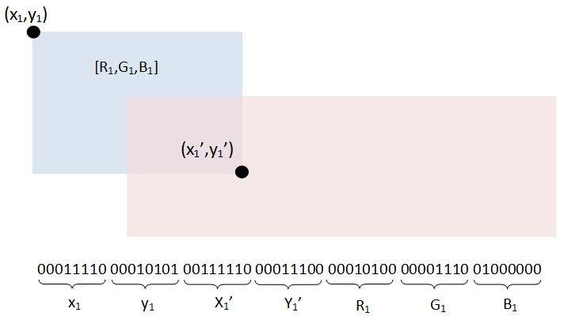
Optional

Slide 59
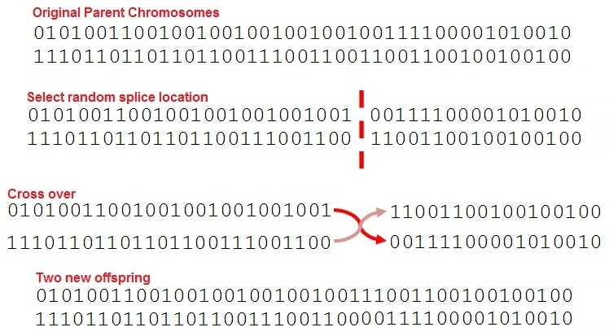
Optional

Slide 60
Gray Code
Optional

Slide 61
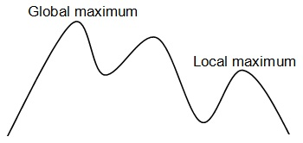
Local Minima/Maximum
Optional

Slide 62
Improvements?
Optional

Slide 63
Genetic Algorithms: Profiling

Slide 65
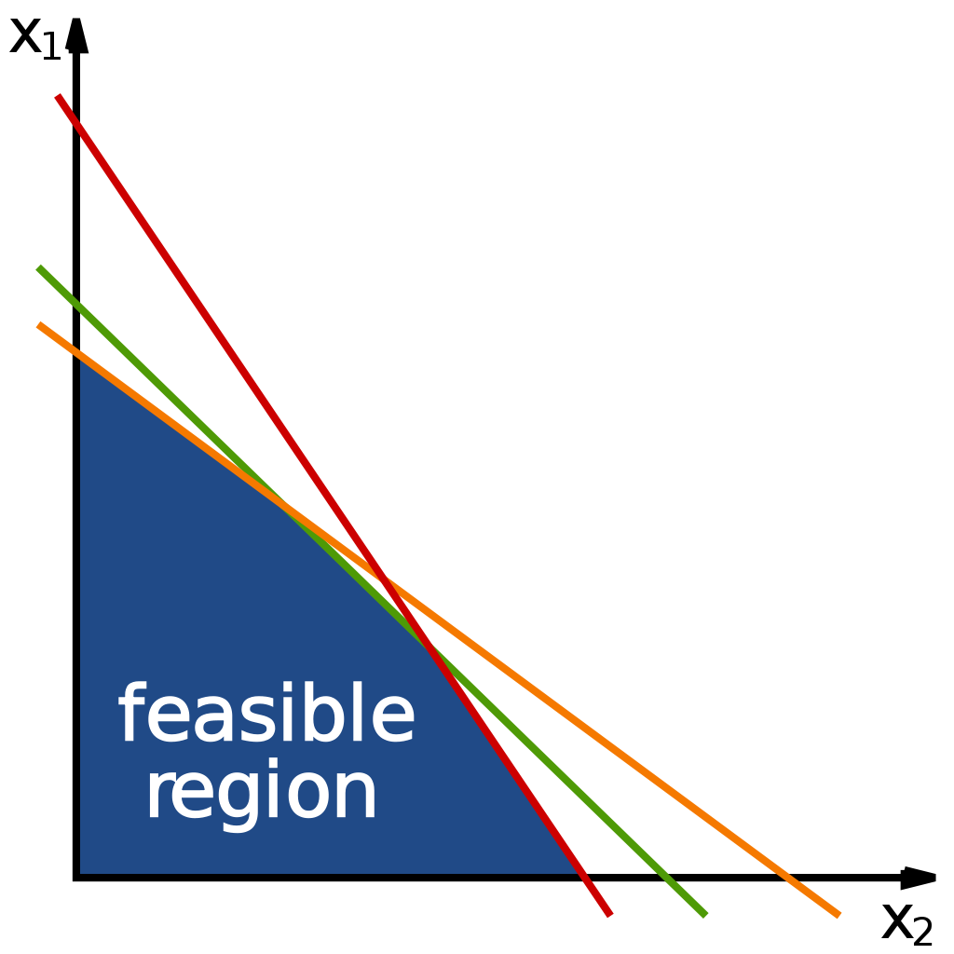
Linear Programming

Slide 66
Example:

Slide 67
Cross Sums
Integer Linear Programming

Slide 68
Cross Sums
8
3
5 | 9
14
e1 + e2 = 8, e2 + e3 = 14? (Nope. There are an infinite number of solutions.)
n11*e1 + n21*e1 + … + n91*e1 + n12*e2 + … + n92*e2 = 8
n12*e2 + n22*e2 + … + n92*e2 + n13*e3 + … + n93*e3 = 14
n11 + n21 + … + n91 = 1

