Slide 1
Topic 16
Limits of Computation (optional)

Slide 2
Survey!

Slide 3
History of (Theoretical) Computing
Cantor and infinities
Bertrand Russell and self-reference
Godel and Incompleteness
Turing and the Halting Problem

Slide 4
Book Plugs
Logicomix
Godel, Escher, and Bach

Slide 5
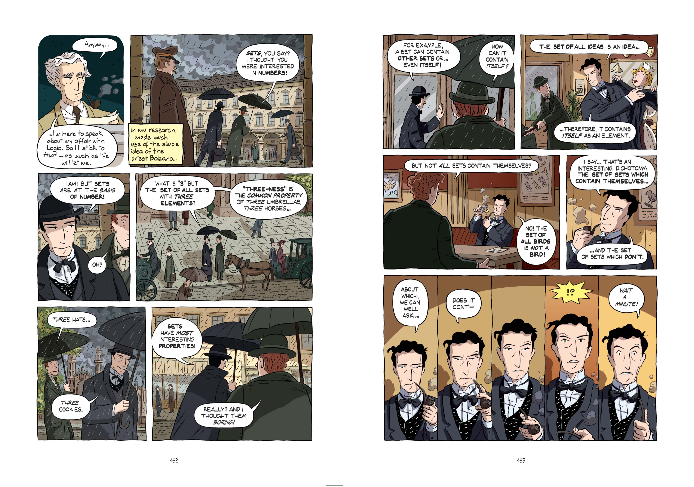

Slide 6
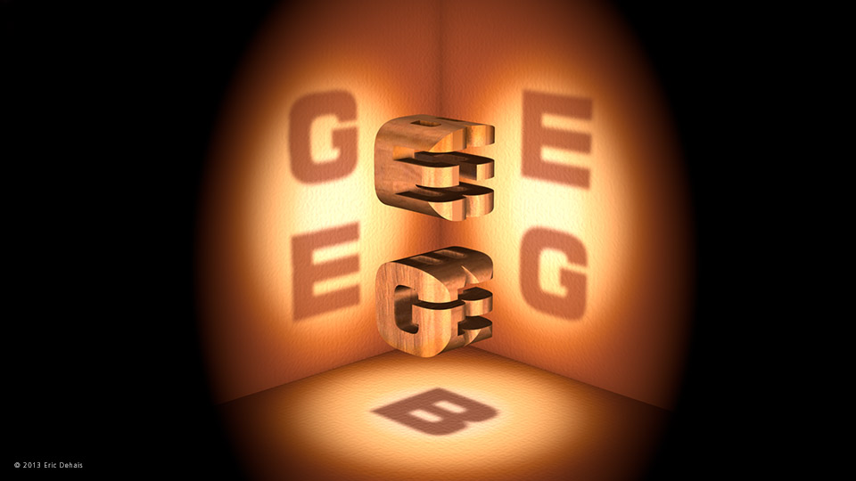
Godel, Escher, and Bach

Slide 7
Cantor and Infinity
Sets invented by George Cantor
Size is defined by cardinality

Slide 8
How many people can you fit in an Infinite Hotel?

Slide 10
Countable
Bijection between the (sub)set of natural numbers and some other set.
{1,2,3} ←→ {-333,135,3.14159…}
{1,2,3,4, …} ←→ {1,-1,2,-2,…}

Slide 11
Are rational numbers countable?

Slide 12
Real Numbers are Uncountable (Diagonalization)

Slide 14
Survey!!!

Slide 15
Russel’s Paradox (Participation)

Slide 16
The Liar Paradox

Slide 17
Aside: Why Proofs?
Knowing for sure.
Understanding the problem
Opening up new ways of thinking
Examples
Euclid’s fifth postulate and projective geometry.
Fermat’s Last Theorem

Slide 18
Russell & Whitehead (Principia Mathematica)

Slide 19
Aside: Why Set Theory?
A foundation for mathematics.
Which allows (in principle) every mathematical statement to be proven

Slide 20
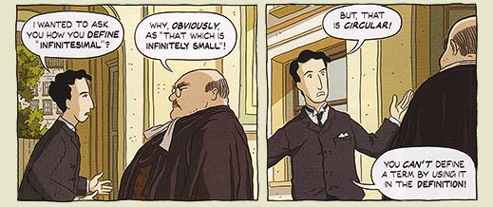

Slide 21
Aside: why do we care about provability?
To get a better understanding of the concepts
To understand its implications
Example: Newton’s calculus
Troll math

Slide 22
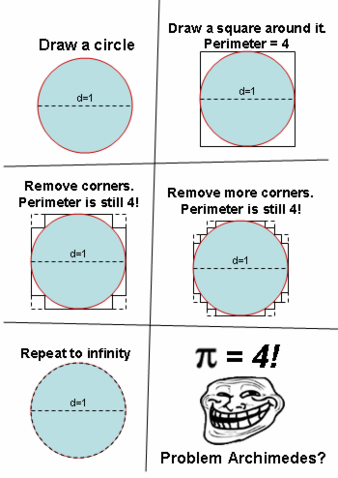

Slide 23
Godel’s Incompleteness Theorem
Hilbert’s program
All mathematical statements should be written in a precise language with well-defined rules
Completeness
Consistency
Etc.

Slide 24
Are all mathematical statements* complete and consistent?
*from a formal theory whose set of axioms are a recursively enumerable set.

Slide 25
Proof ideas
Construct a bijection between logical statements and natural numbers
Every statement has a unique ID (Godel numbering)
Can construct statements with numbers like “statement S is provable in system”
Make a self-referential statement that says “this statement is unprovable in this system”
Diagonalization

Slide 26
Turing Machines

Slide 27
Theoretical Computation
Automata, Grammars, and Computability (473)
DFA → PDA → Turing Machines
P, NP, NP-hard, NP-Complete

Slide 31
Halting Problem
Can we decide (say ‘yes’ or ‘no’ in finite time) whether any mathematical statement is even provable?
Can a program determine whether any program will halt eventually?

Slide 32
Diagonalization in the Halting Problem

